Slide 1
Languages

Slide 2
Language: a set of strings
String: a sequence of symbols
from some alphabet
Example:
Strings: cat, dog, house
Language: {cat, dog, house}
Alphabet:

Slide 3
Alphabets and Strings
An alphabet is a set of symbols
Example Alphabet:
A string is a sequence of
symbols from the alphabet
Example Strings

Slide 4
Decimal numbers alphabet
Strings
Binary numbers alphabet
Strings

Slide 5
String Operations
Strings
Concatenation : concatenation of two strings w and v is the string obtained by appending the symbols of v to the right end of w, denoted by wv.

Slide 6
Strings
Reverse: Reverse of a string is obtained by writing the symbols in reverse order. Reverse of the string w is denoted by w^{R}
x ^{R} = bbbaaababa

Slide 7
String Length: length of a string w, denoted by |w|, is the number of symbols in the string.
Length:
Examples:

Slide 8
Length of Concatenation
Example:

Slide 9
Empty String
A string with no letters is denoted:
Observations:

Slide 10
Substring
Substring of string:
Any string of consecutive symbols in some string
String Substring

Slide 11
Prefix and Suffix
Prefixes
Suffixes
prefix
suffix

Slide 12
Concatenation Operation with the same string n times
Example:
Definition:

Slide 13
Star closure Operation(*)
: the set of all possible strings from
alphabet

Slide 14
Positive closure operation(+ )
: the set of all possible strings from
alphabet except

Slide 15
Languages
A language over alphabet
is any subset of
Examples:
Language:
Language:
Language:

Slide 16
More Language Examples
An infinite language
Alphabet

Slide 17
Prime numbers
Alphabet
Language:

Slide 18
Even and odd numbers
Alphabet

Slide 19
Note that:
Sets
Set size
Set size
String length

Slide 20
Operations on Languages
The usual set operations
Complement:

Slide 21
Reverse
Definition:
Examples:

Slide 22
Concatenation
Definition:
Example:

Slide 23
Another Operation
Definition:
Special case:

Slide 25
Star-Closure (Kleene *)
All strings that can be constructed from
Definition:
Example:

Slide 26
Positive Closure
Definition:
Same with but without the

Slide 27
Review Questions
1.Let L = {ab, aa, baa}.
a) Which of the following strings are in L*: abaabaaabaa, aaaabaaaa, baaaaabaaaab, baaaaabaa?
b) Which strings are in L⁴?
2. Let ∑ = {a, b} and L = {aa, bb}. Use set notation to describe complement of L.

Slide 28
Conti…
3.Find the languages for ∑ = {a, b} that generate the sets of
all strings with exactly one a.
all strings with at least one a.
all strings with no more than three a’s.
all strings with at least three a’s
4. Let ∑ = {0,1} and L={00,11} find
a. L²
b. L⁴
C. L* and L⁺

Slide 29
Discussions on Answers to Review Questions and Clarifications Session

Slide 30
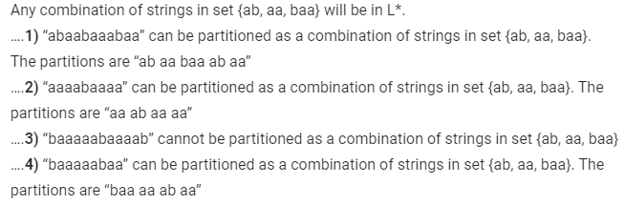
Answers to review questions
1.Let L = {ab, aa, baa}.
a) Which of the following strings are in L*: abaabaaabaa, aaaabaaaa, baaaaabaaaab, baaaaabaa?
Answer – a)

Slide 31

Answers to review questions
1.Let L = {ab, aa, baa}.
abaabaaabaa,
aaaabaaaa,
baaaaabaaaab,
baaaaabaa
b) Which strings are in L⁴?
Answer – b)

Slide 32
Answers to review questions
2. Let ∑ = {a, b} and L = {aa, bb}. Use set notation to describe complement of L. (With Clues – Options)
(A) {λ, a, b, ab, ba} ∪ {w∈{a, b}* | |w| > 3} (B) {a, b, ab, ba} ∪ {w∈{a, b}* | |w| > 3} (C) {w ∈ { a, b}* | |w| > 3} ∪ {a, b, ab, ba} (D) {λ, a, b, ab, ba} ∪ {w ∈ {a, b}* | |w| ≥ 3}
Answer
Strings generated by language L = {aa, bb} will be even length. So, complement will be universal set of stringgs – {aa, bb}. i.e. {λ, a, b, ab, ba} and strings {w ∈ {a, b}* | |w| ≥ 3}, i.e. strings of length greater than or equal to 3.
(D)

Slide 33
Answers to review questions
3.Find the languages for ∑ = {a, b} that generate the sets of
all strings with exactly one a.
all strings with at least one a.
all strings with no more than three a’s.
all strings with at least three a’s
Answer
Refer next slide

Slide 34
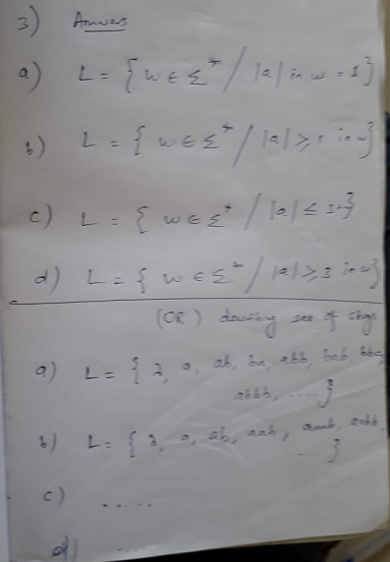

Slide 35
Answers to review questions
4. Let ∑ = {0,1} and L={00,11} find
a. L²
b. L⁴
C. L* and L⁺
Answer
Refer next slide

Slide 36
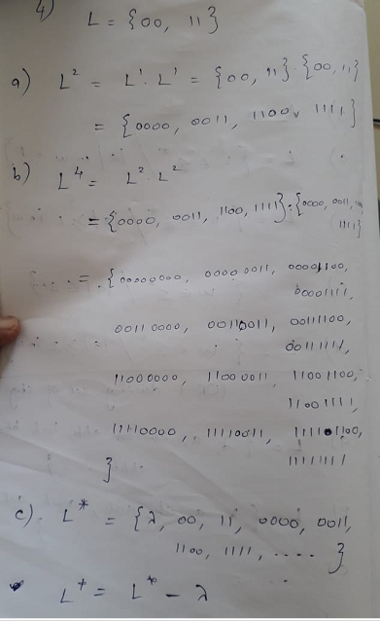

Slide 37
Thank you to All my Dear Students

